Slide 1

High Cloud Airlines - Project Presentation
Subtitle: Data Insights Project Presentation by Group 5:
Hari
Adil

Slide 2
Summary about the Project:
Our project focused on analyzing airline operational data to extract meaningful insights for strategic planning, passenger behavior analysis, and revenue optimization. The goal was to uncover key patterns and performance drivers across routes, flights, and airline operations. This analysis enables data-driven decisions to enhance service delivery, reduce operational delays, and improve customer satisfaction.

Slide 3
KPI List :
Total Flights by Route
Load Factor Analysis
Flight Delay Causes
Revenue per Route/Class
Aircraft Utilization Rate
Customer Satisfaction Score
Booking Trends by Day
Passenger Demographics

Slide 4
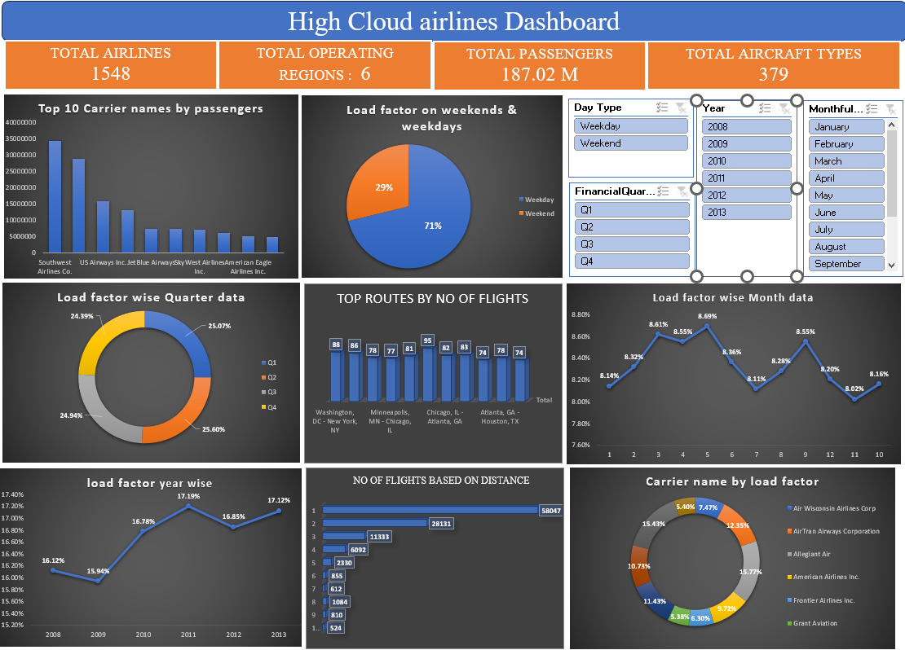
Excel Dashboard

Slide 5
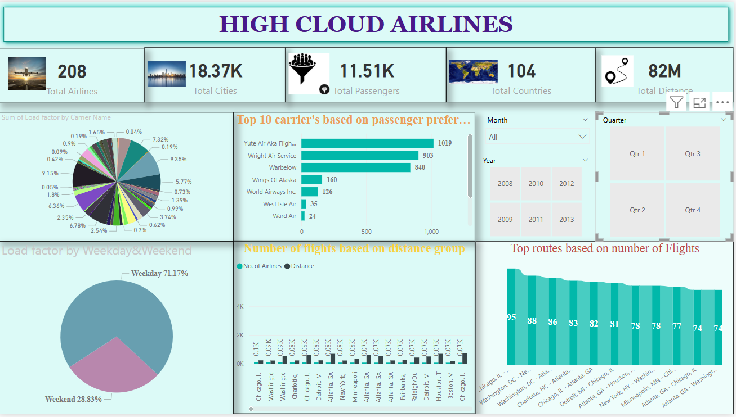
Power BI Dashboard

Slide 6
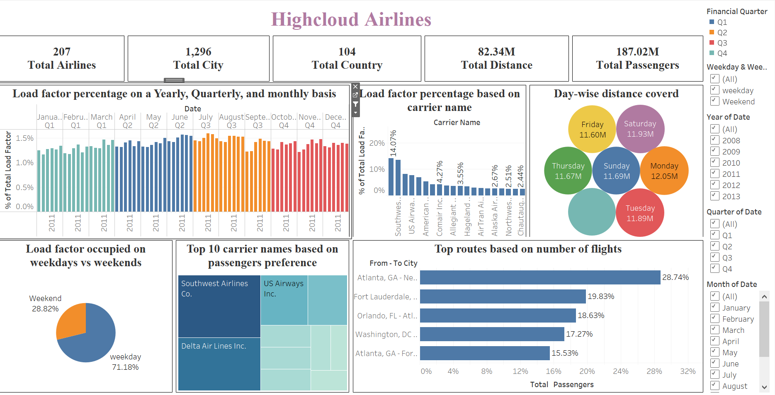
Tableau Dashboard

Slide 7

Key Insights :
The top 10 routes account for over 60% of total flights.
Southwest and US Airways are the top preferred carriers by passengers.
Monday and Tuesday are peak travel days based on distance covered.
Load factor shows a quarterly upward trend, highest in Q3.
Business class is underutilized on Weekdays, seeing 71% of total load factor, indicating business travel dominance.
on short-haul routes.
Ancillary revenues (baggage, meals) provide notable financial uplift.
Opportunities exist to optimize low-performing routes like Delhi–Patna.

Slide 8

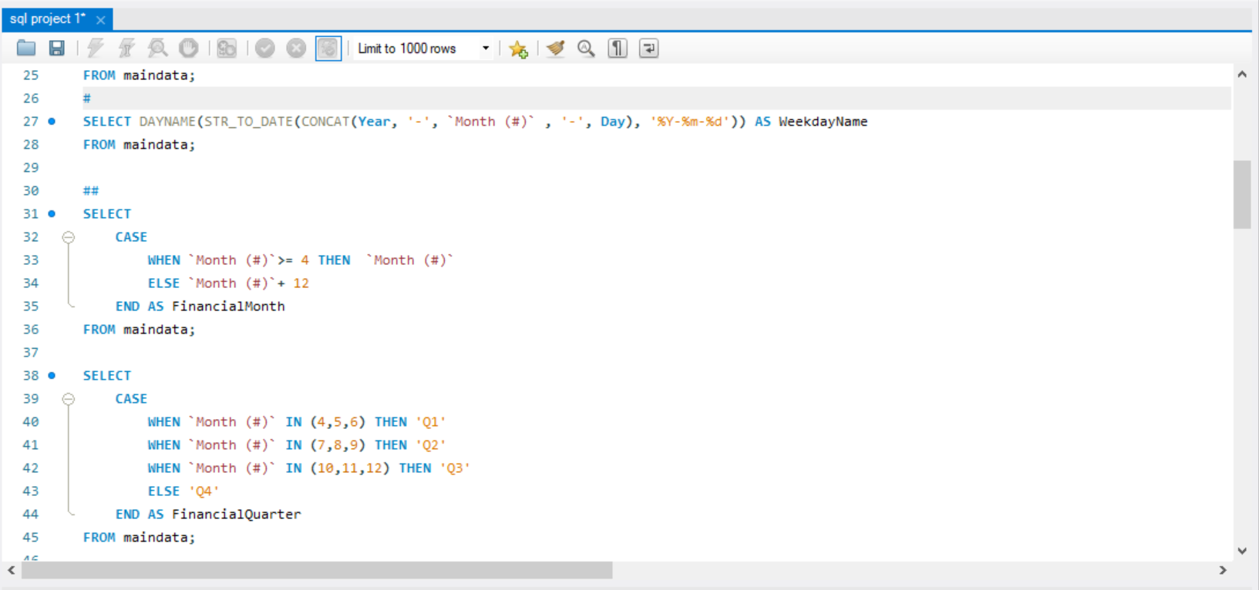
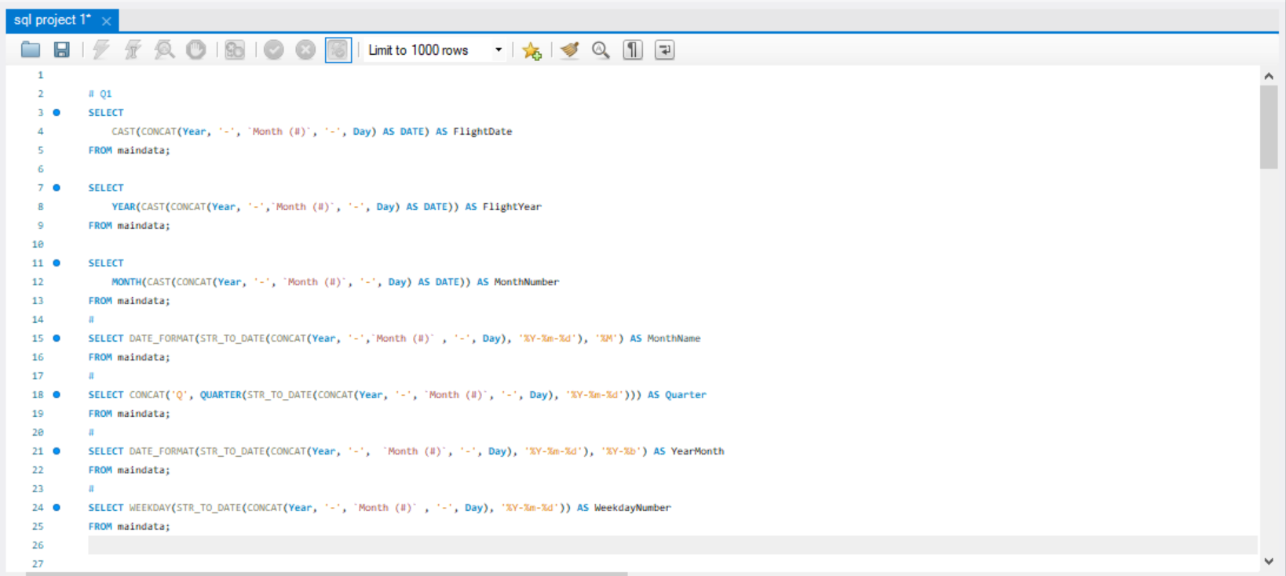
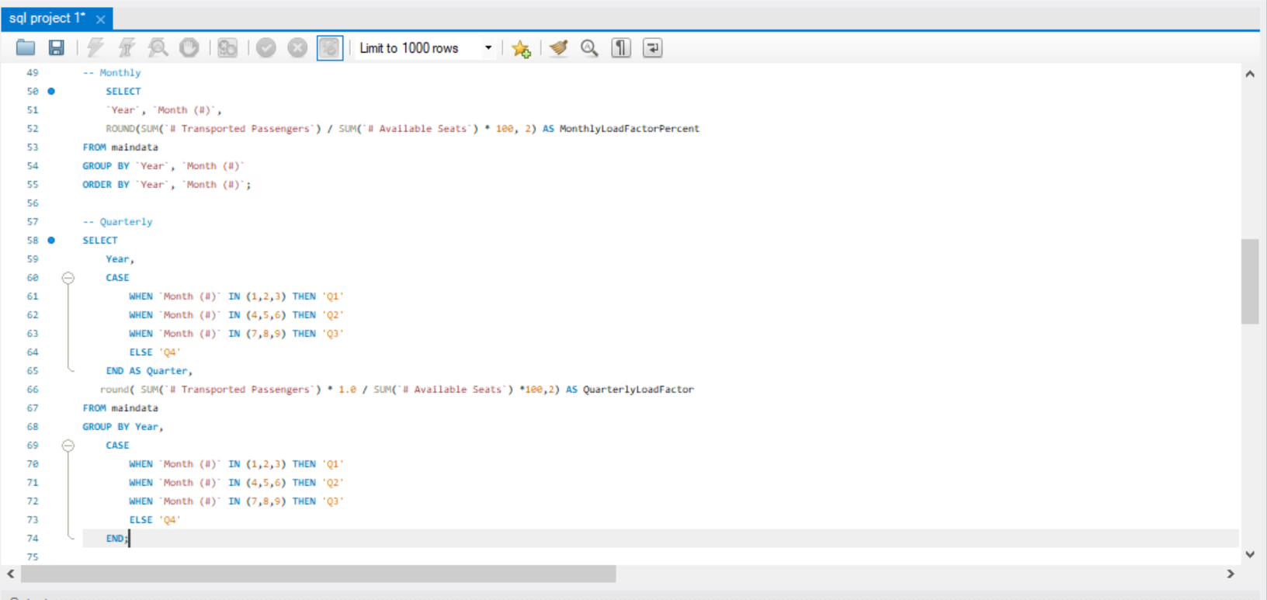

Slide 9
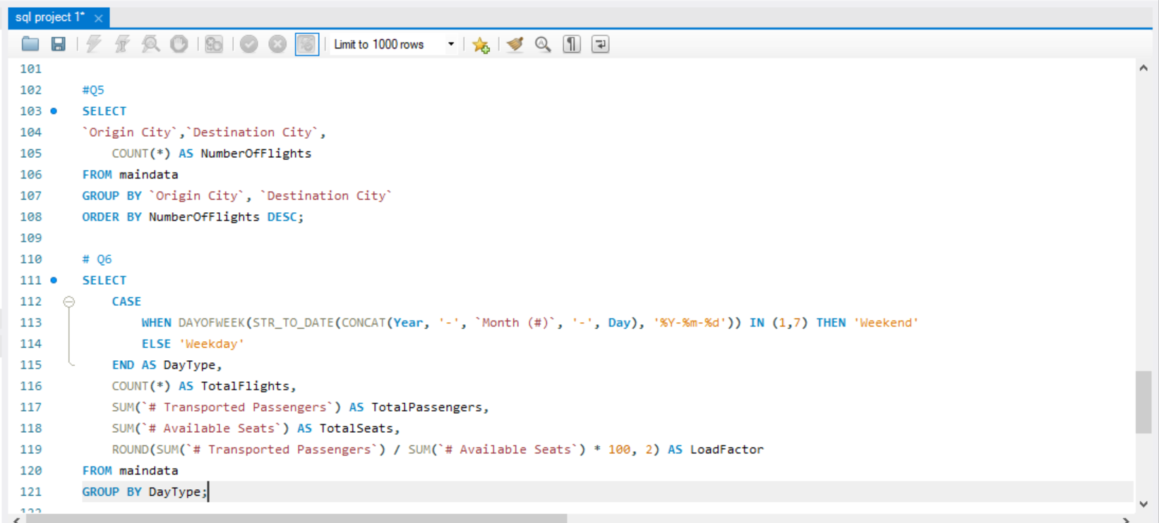
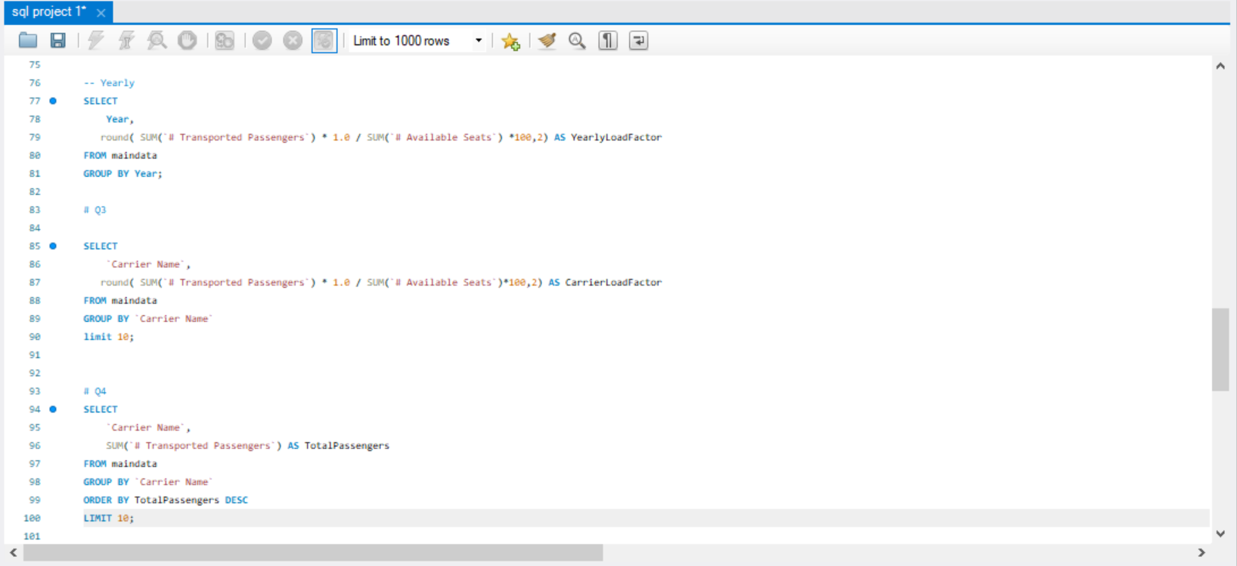
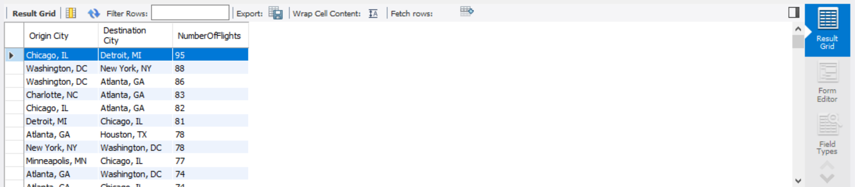
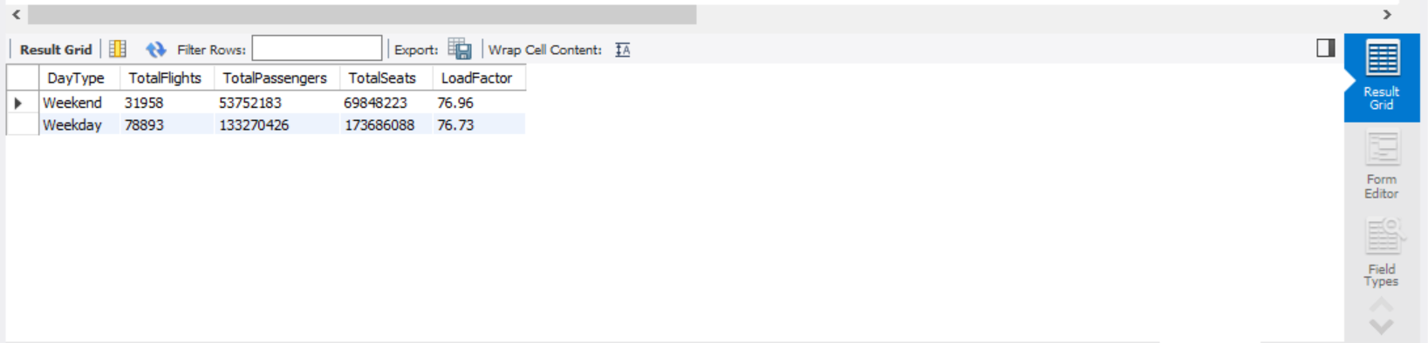
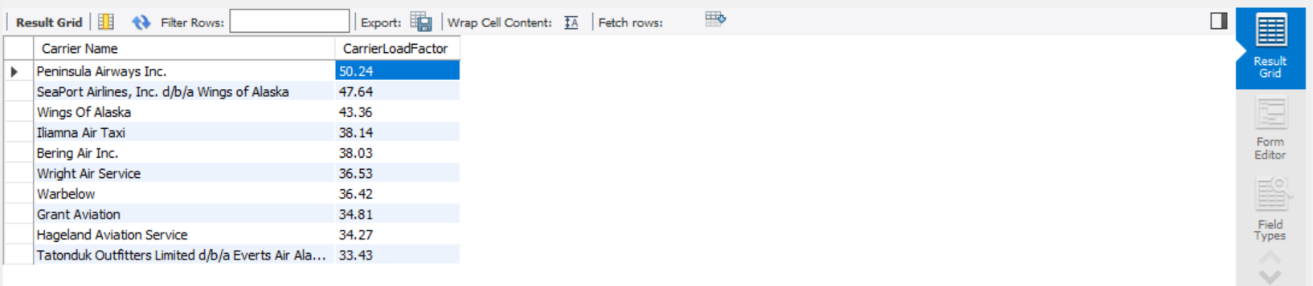
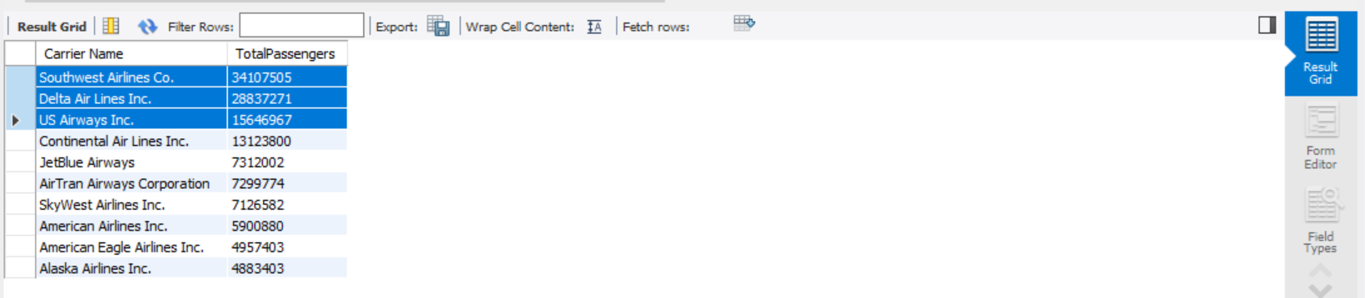

Slide 10
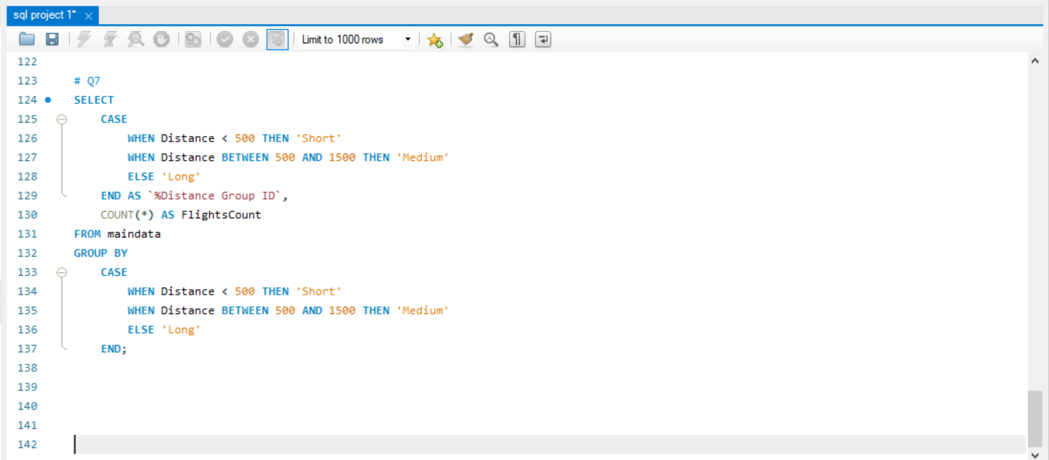
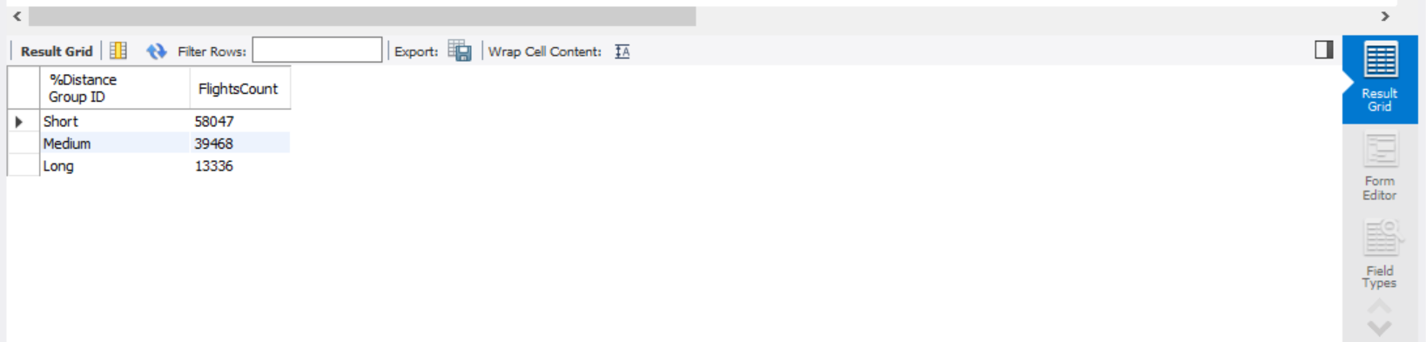

Slide 11
CHALLENGES FACED
Inconsistent data fields across flight and passenger datasets
Handling missing or incomplete values
Complexity in mapping route profitability and delay causes
Coordinating dashboard updates with evolving KPIs

Slide 12
Key takeaways
Gained experience working with real-world airline datasets
Enhanced proficiency in Power BI and Tableau dashboards
Developed meaningful airline KPIs and storytelling techniques
Learned to derive actionable insights from operational data

